Slide 1
height (thickness)
width
Length Units = meters
Time units = days
K = 1 m/d
10 m
length
Constant head boundary 15m
Constant head boundary 10m

Slide 2
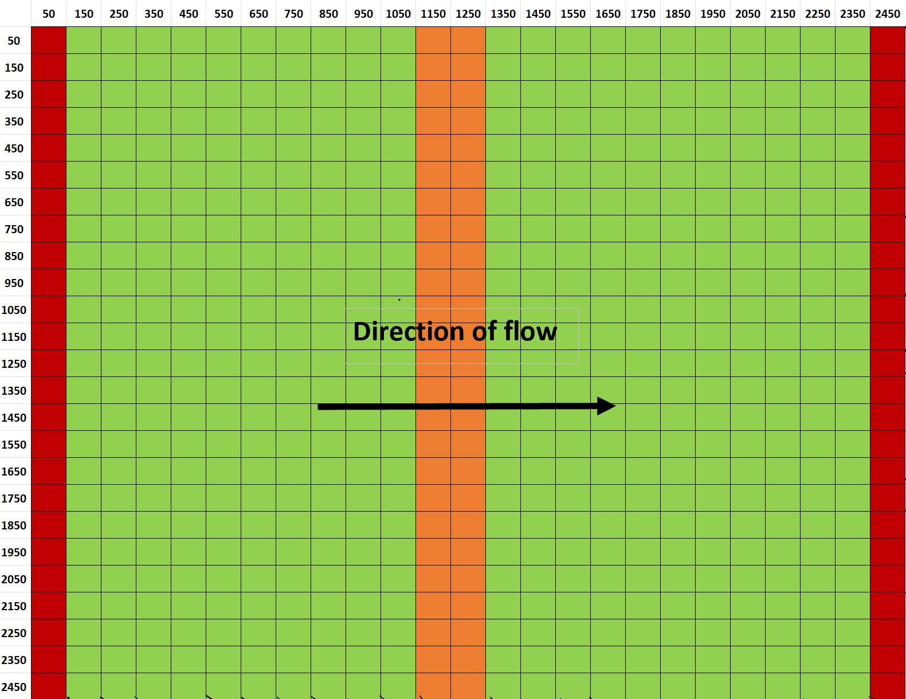
height (thickness)
K = 1 m/d
K = 0.1 m/d
K = 1 m/d
width
Length Units = meters
Time units = days
K = 1 m/d
10 m
length
Constant head boundary 15m
Constant head boundary 10m

Slide 3
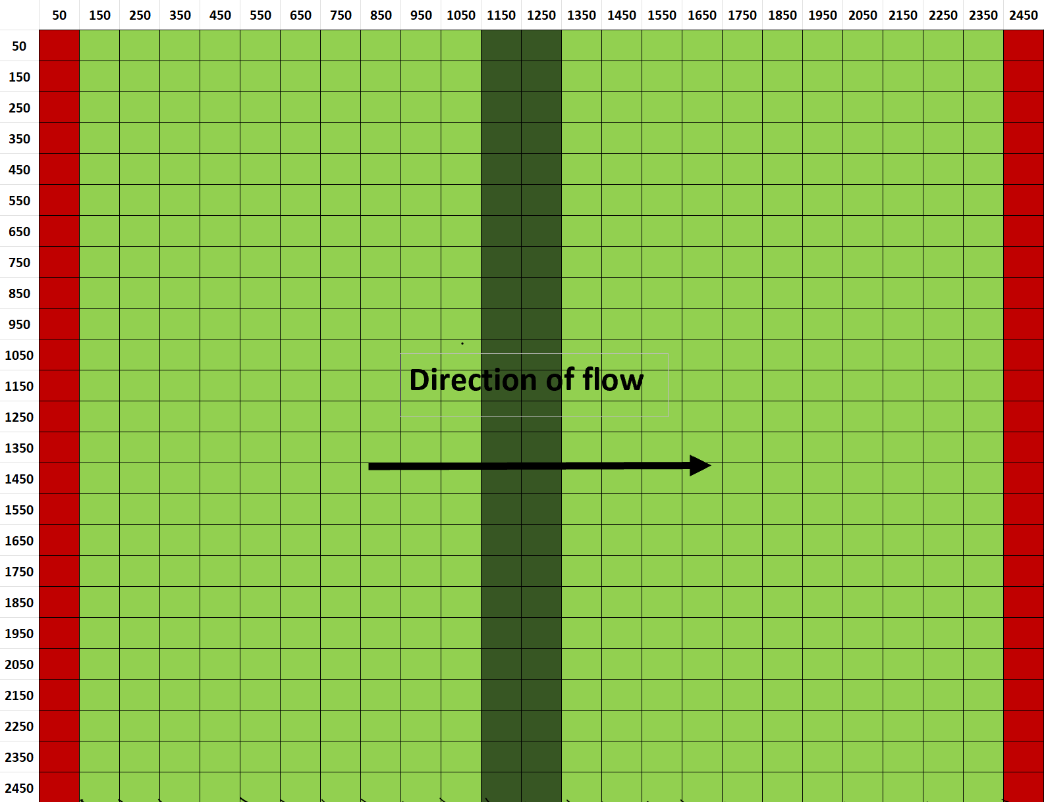
height (thickness)
K = 1 m/d
K = 10 m/d
K = 1 m/d
width
Length Units = meters
Time units = days
K = 1 m/d
10 m
length
Constant head boundary 15m
Constant head boundary 10m

Slide 4
height (thickness)
width
Length Units = meters
Time units = days
K = 1 m/d
10 m
length
Constant head boundary 15m
Constant head boundary 10m

